Slide 1
Solar Charger
Amlan Chakraborty 18.02.04.009
Ishraque Navid Niloy 18.02.04.010
Shadman Sakib 18.02.04.019
Lutfunnesa Suzana 18.02.04.035

Slide 2
What is our Solar charger-
We made a solar device that will track the sun and use the energy to charge devices like phone chargers

Slide 3
Social Values
The main theme of this Arduino project is to use the power
The energy is even free of cost
Doesn’t require the use of any fossil fuel
Less or no maintenance cost

Slide 4
Required Components
Arduino Uno
Gear Motor
Photo Resistor
Resistor 1k ohm
Step Up DC-DC Boost Converter 3V to 5V 1A USB Charger
N4007 Diode
TP4056 5V 1A Micro USB 18650 Lithium Battery Charging and Protection Board
3.7V Battery
Battery Holder
L9110 Motor Control Board
Solar Panel
Wires

Slide 5
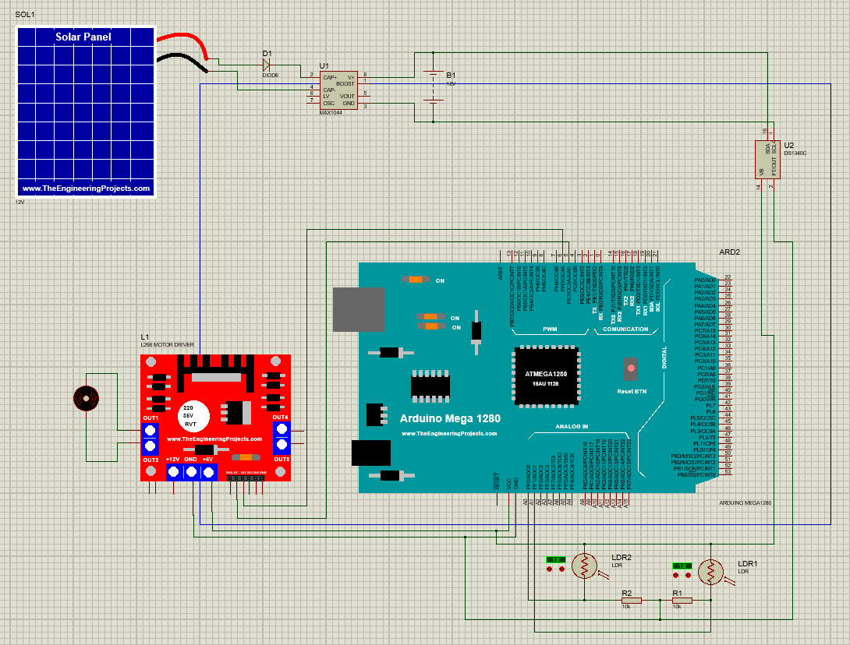
Diagram:

Slide 6
Final Expenditure
Equipment | Buying Price total (Tk) | Quantity | Budget (Tk)
Arduino Uno | 749 | 1 | 750
Gear Motor | 450 | 1 | 100
Photo Resistor | 100 | 4 | 160
Resistor 1k ohm | 20 | 5 | 25
Step Up DC-DC Boost Converter 3V to 5V 1A USB Charger | 500 | 2 | 1100
N4007 Diode | 6 | 2 | 25
TP4056 5V 1A Micro USB 18650 Lithium Battery Charging and Protection Board | 80 | 2 | 80
3.7V Battery | 150 | 2 | 80
Battery Holder | 55 | 1 | 60
L9110 Motor Control Board | 120 | 1 | 200
Solar Panel | 598 | 2 | 700
Wires | 190 |  | 200
Total | 3018 |  | 3500

Slide 7
Challenges :
We have faced:
Welding the wires to the circuits
Making the structure of the system
Managing the tangling wires
Setting up the motor and getting all the connections
We may face:
The panels may get too hot
Maintenance of the solar panel

Slide 8
Thank you

